Slide 1
Netflix Content Analytics
Data Cleaning • EDA • Statistical Analysis • KPIs • Business Insights
Graduation Project Presentation
Abdallah Nasrallah - 202010940
Supervisor: Wasef Matar

Slide 2
1. Project Objectives
Understand the structure and quality of the Netflix titles dataset.
Clean and transform the data to make it analysis-ready.
Perform Exploratory Data Analysis (EDA) using descriptive statistics and visualizations.
Calculate meaningful KPIs that summarize Netflix's content library.
Identify content, genre, country, rating, and release-year patterns.
Translate analytical findings into practical business recommendations.
Netflix Content Analytics | Graduation Project

Slide 3
2. Methodology & Data Preparation
Source dataset: Netflix titles dataset containing movies and TV shows.
Tools: Python (Pandas, NumPy, Matplotlib) and Microsoft Excel.
Data cleansing: duplicate review/removal, missing-value assessment, type conversion, and date parsing.
Data transformation: extracted year_added and month_added from date_added; separated duration_value and duration_unit.
EDA: content mix, genres, countries, ratings, release years, and duration analysis.
Statistical analysis: mean, median, standard deviation, minimum, and maximum.
Netflix Content Analytics | Graduation Project

Slide 4
3. Project KPIs
8,807
Total Titles
6,131
Movies
2,676
TV Shows
69.6%
Movie Share
30.4%
TV Show Share
99.6 min
Avg. Movie Duration
98 min
Median Movie Duration
2014
Avg. Release Year
Netflix Content Analytics | Graduation Project

Slide 5
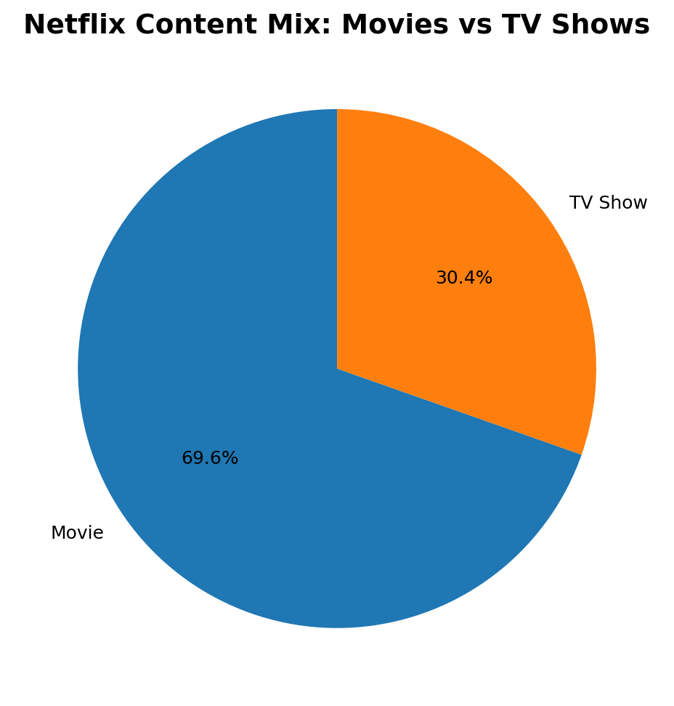
4. Content Type Distribution
Key Insight
Movies account for 69.6% of the dataset, while TV Shows account for 30.4%. This indicates a strong movie-oriented content mix.
Netflix Content Analytics | Graduation Project

Slide 6
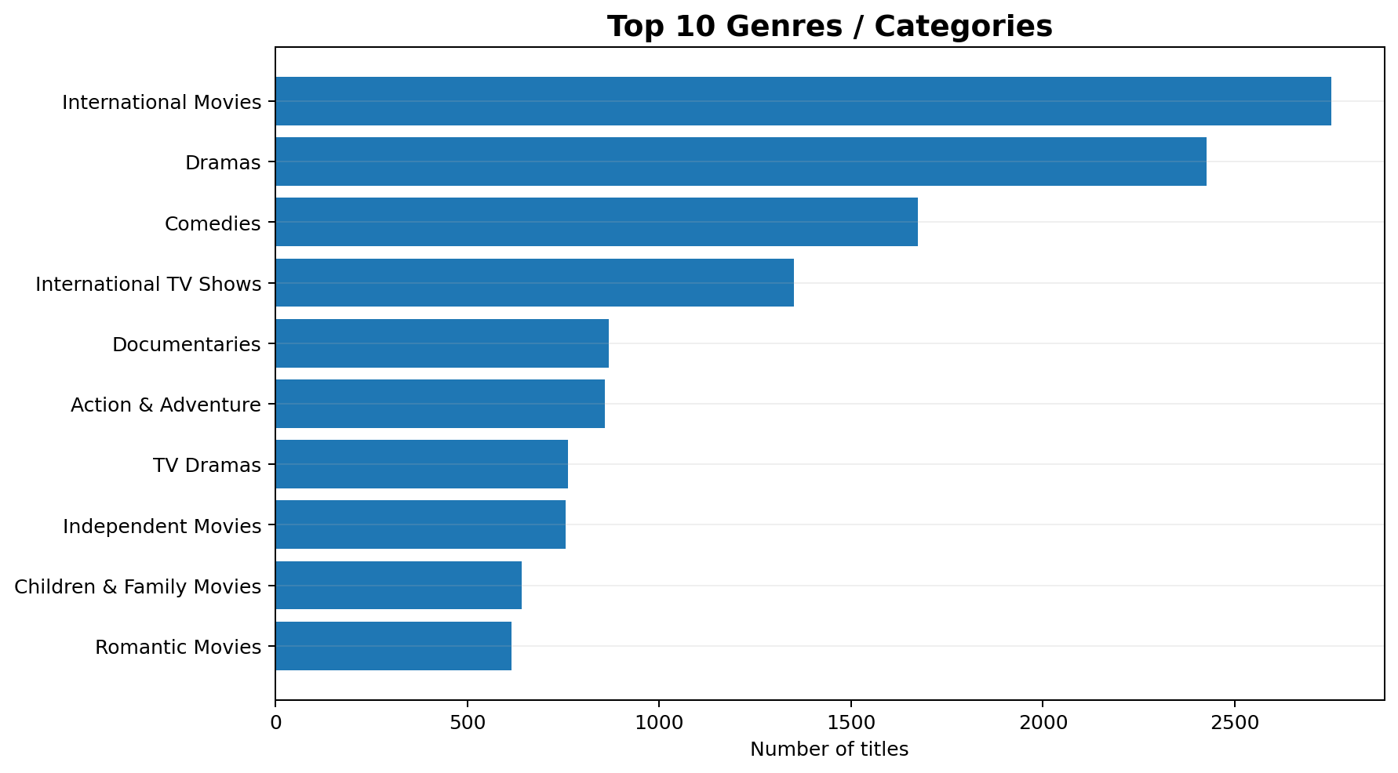
5. Top Genres / Categories
Key Insight
The leading category is 'International Movies', with 2,752 title appearances. Genre concentration helps identify where the catalog is strongest.
Netflix Content Analytics | Graduation Project

Slide 7
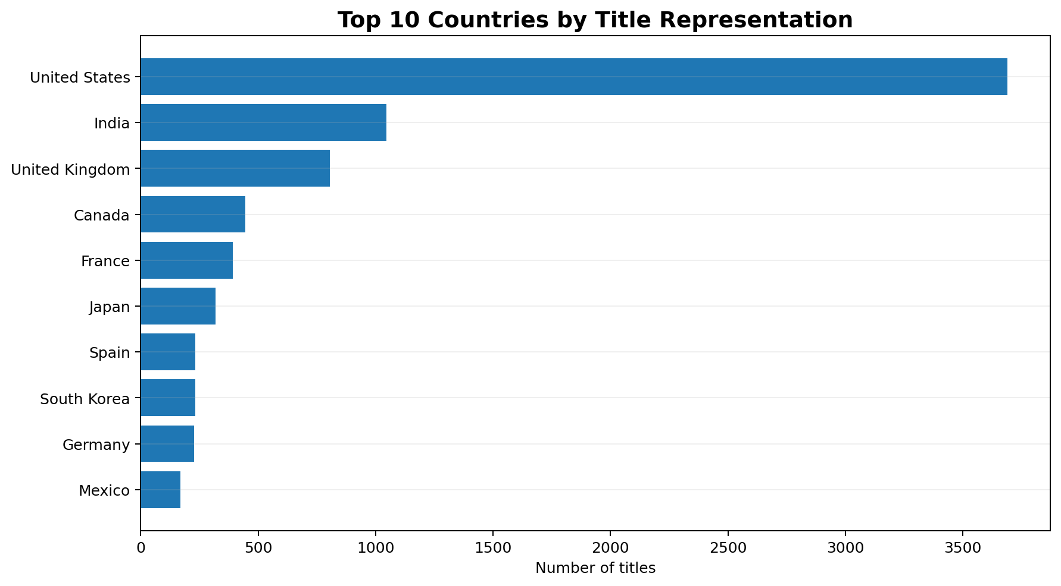
6. Geographic Distribution
Key Insight
United States has the highest number of country-tagged title appearances. International representation is an important dimension of Netflix's catalog strategy.
Netflix Content Analytics | Graduation Project

Slide 8
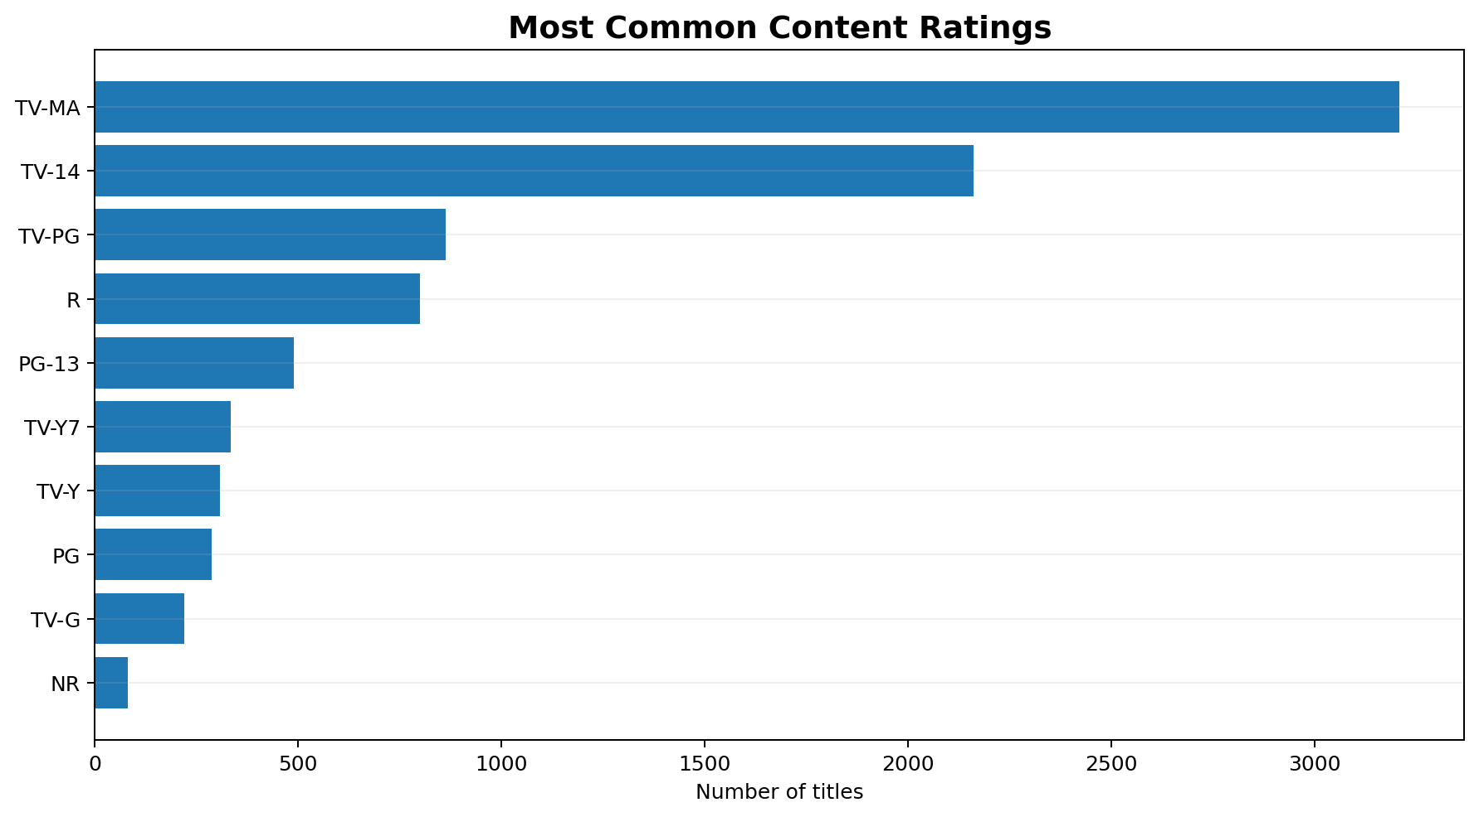
7. Content Ratings
Key Insight
The most common rating is TV-MA (3,207 titles). Ratings reveal the dominant audience segments represented in the catalog.
Netflix Content Analytics | Graduation Project

Slide 9
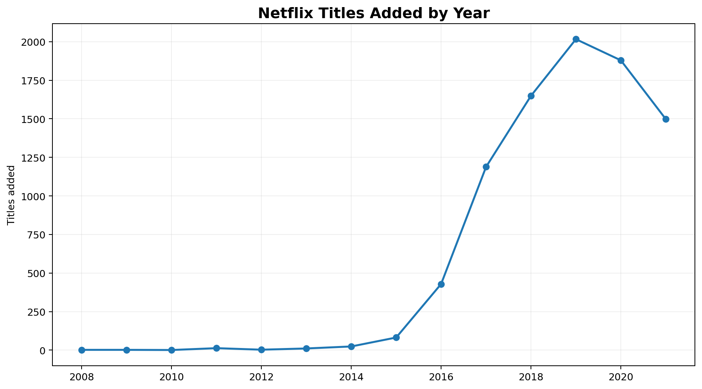
8. Titles Added Over Time
Key Insight
The dataset shows strong growth in titles added during the late 2010s and early 2020s, reflecting Netflix's rapid catalog expansion.
Netflix Content Analytics | Graduation Project

Slide 10
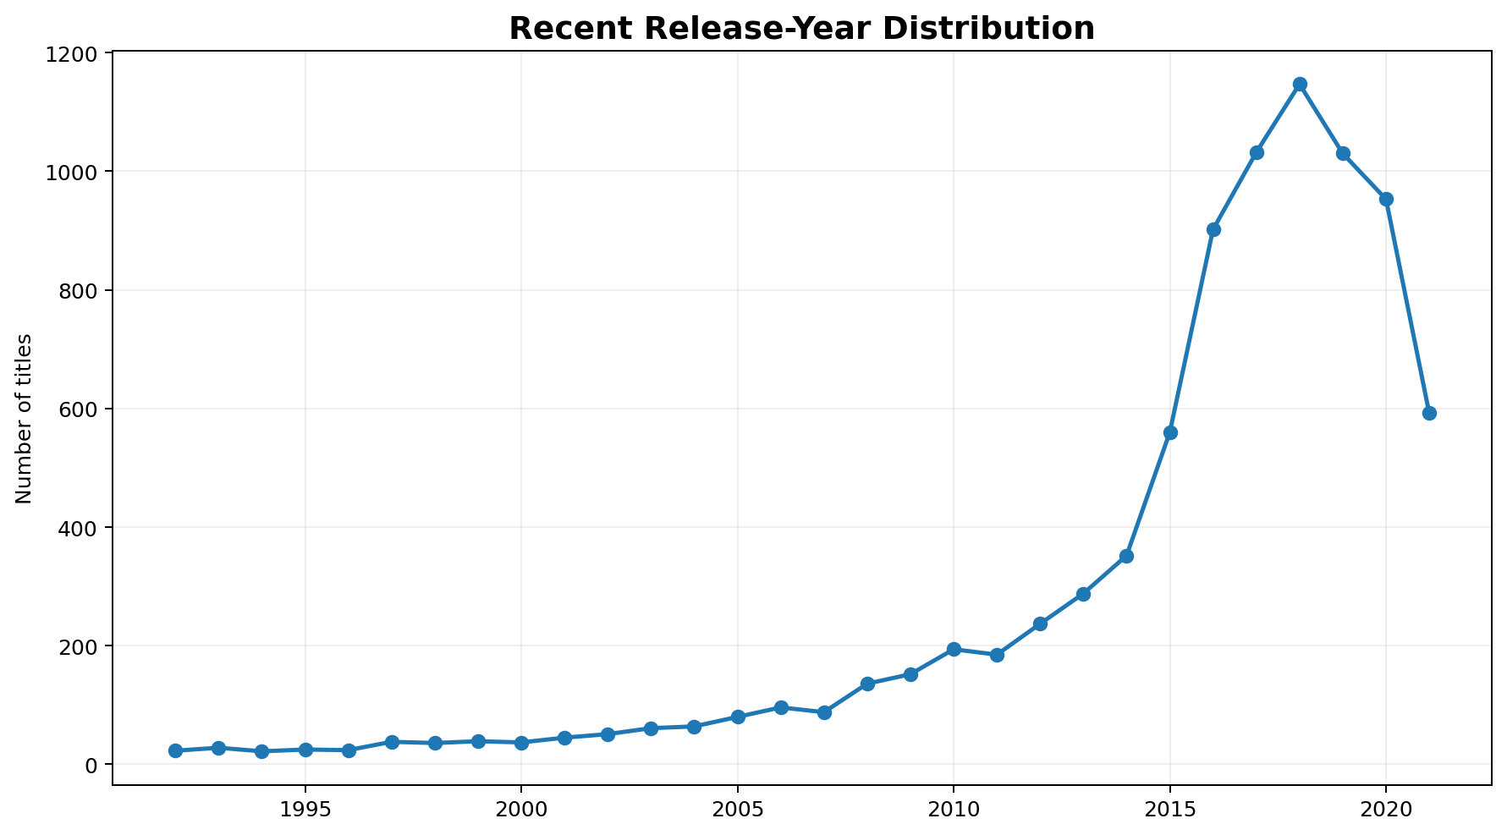
9. Release-Year Trend
Key Insight
Recent release years contain a large share of the catalog, indicating a strong focus on relatively modern content.
Netflix Content Analytics | Graduation Project

Slide 11
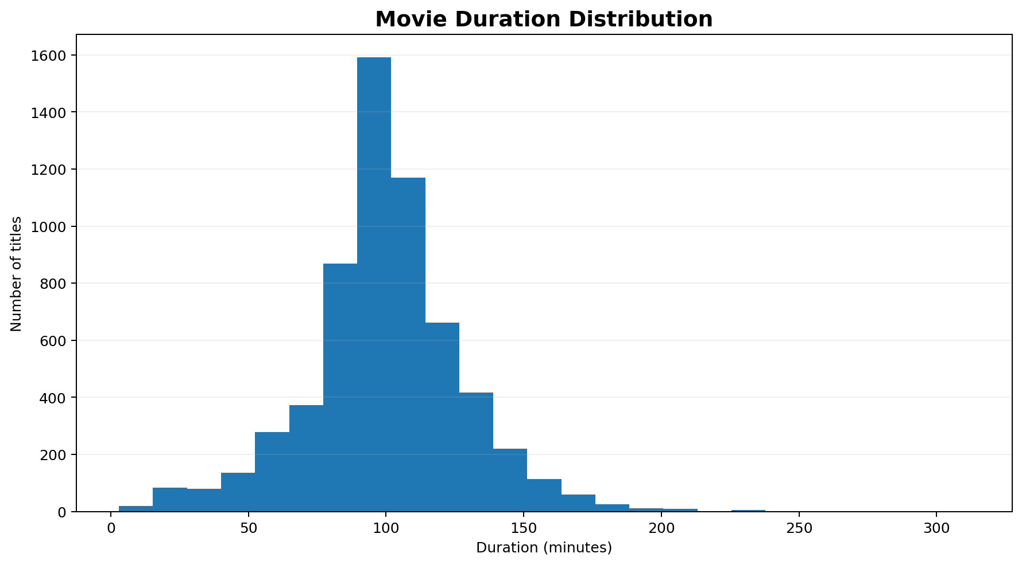
10. Movie Duration Analysis
Key Insight
Average movie duration is 99.6 minutes, median is 98 minutes, and standard deviation is 28.3 minutes. The difference between mean and median indicates some variation in movie lengths.
Netflix Content Analytics | Graduation Project

Slide 12
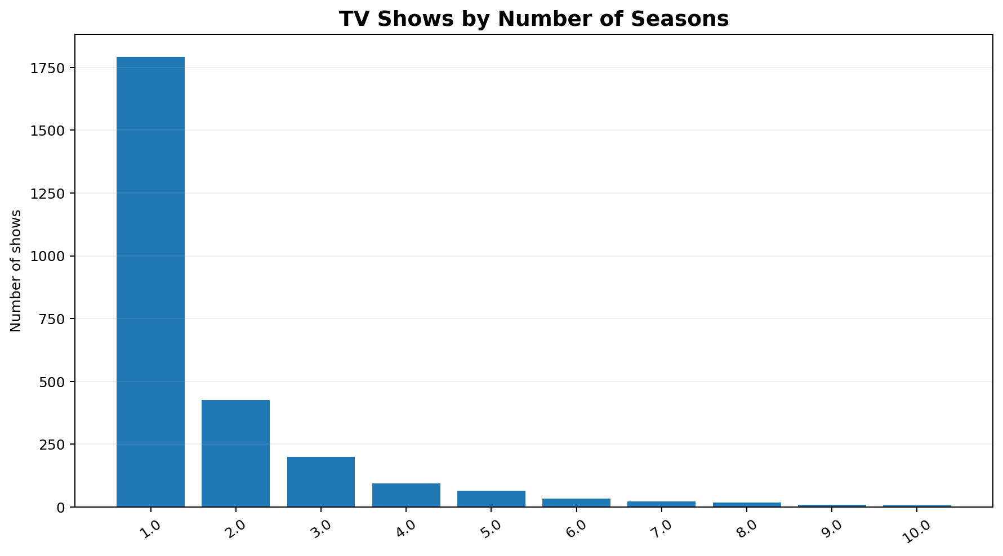
11. TV Show Season Analysis
Key Insight
Most TV shows have a small number of seasons. This metric can support analysis of short-form versus long-running series.
Netflix Content Analytics | Graduation Project

Slide 13
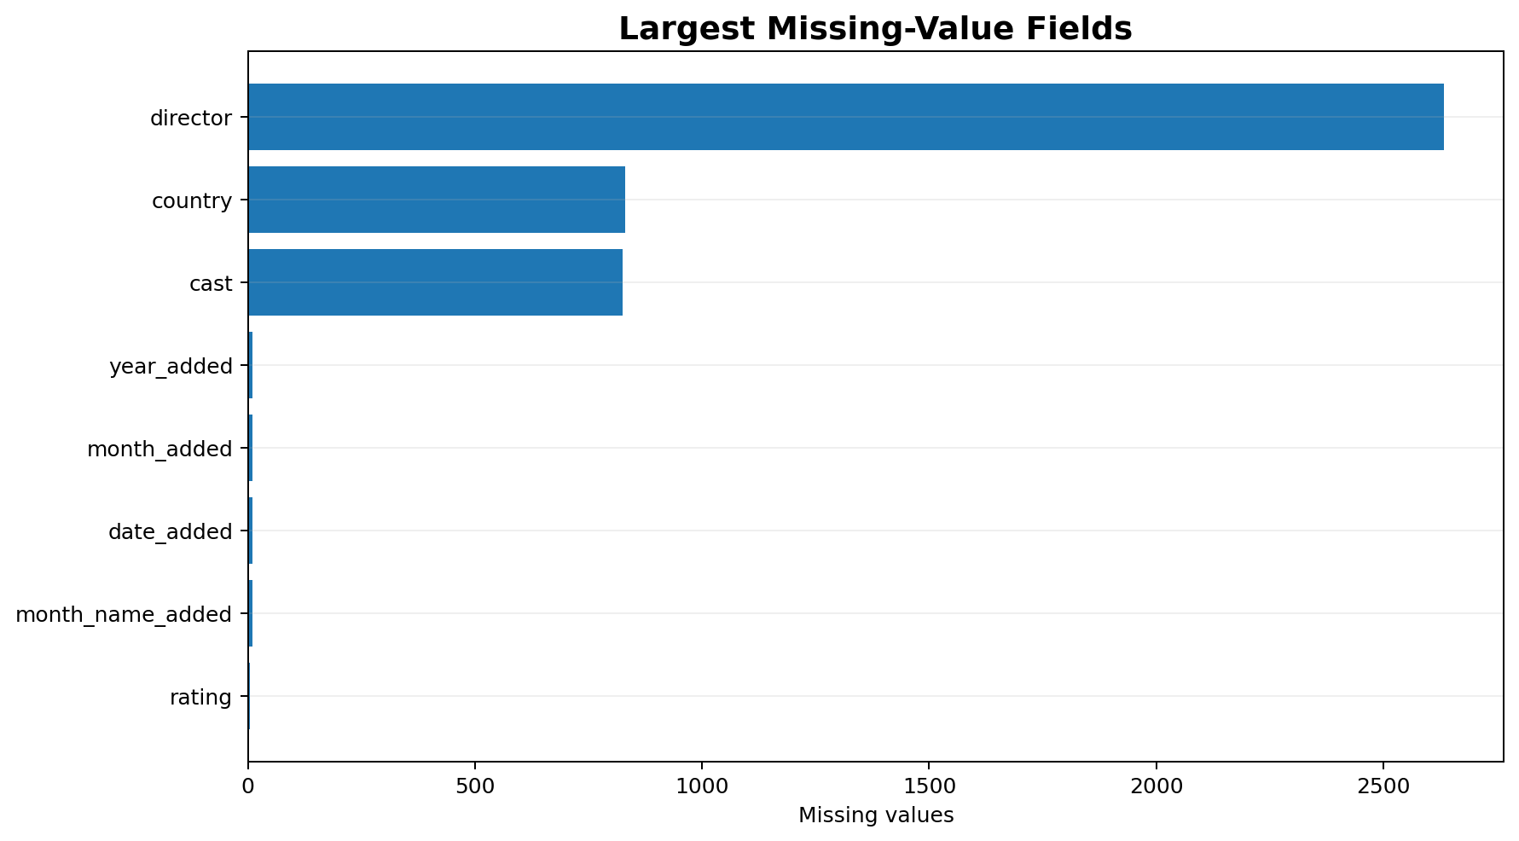
12. Missing-Value Analysis
Key Insight
Missing values are concentrated in fields such as director, cast, and country. These fields should be interpreted carefully rather than automatically treating missing values as zero or 'none'.
Netflix Content Analytics | Graduation Project

Slide 14
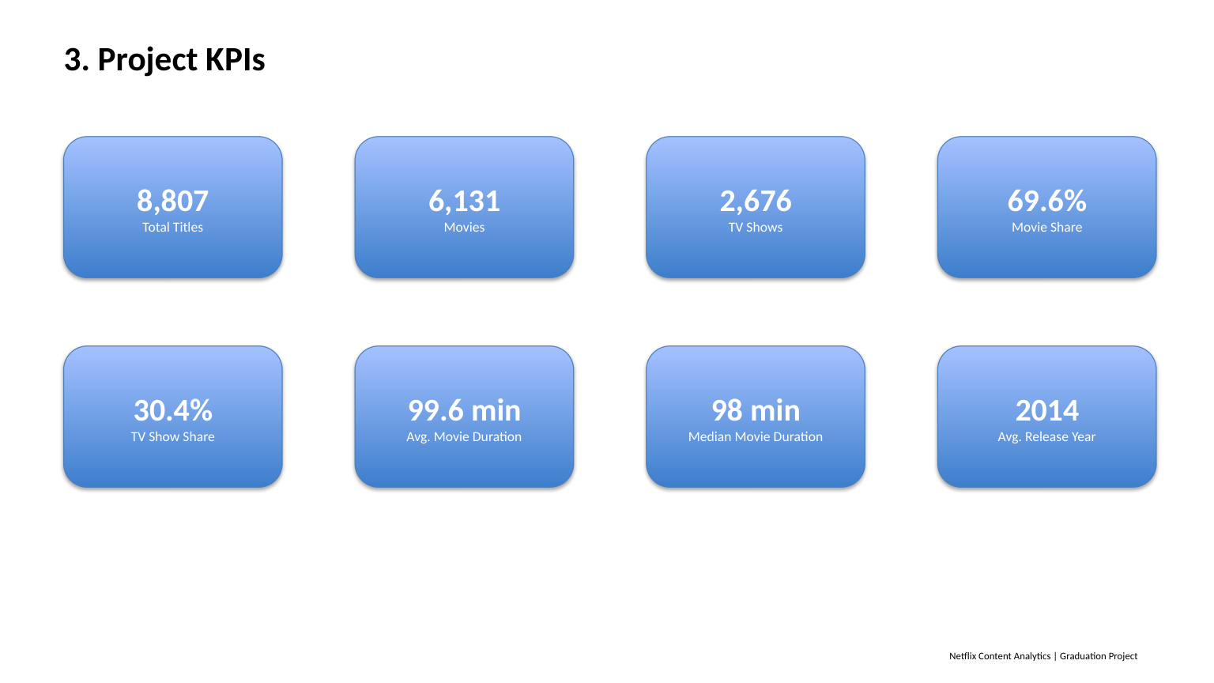
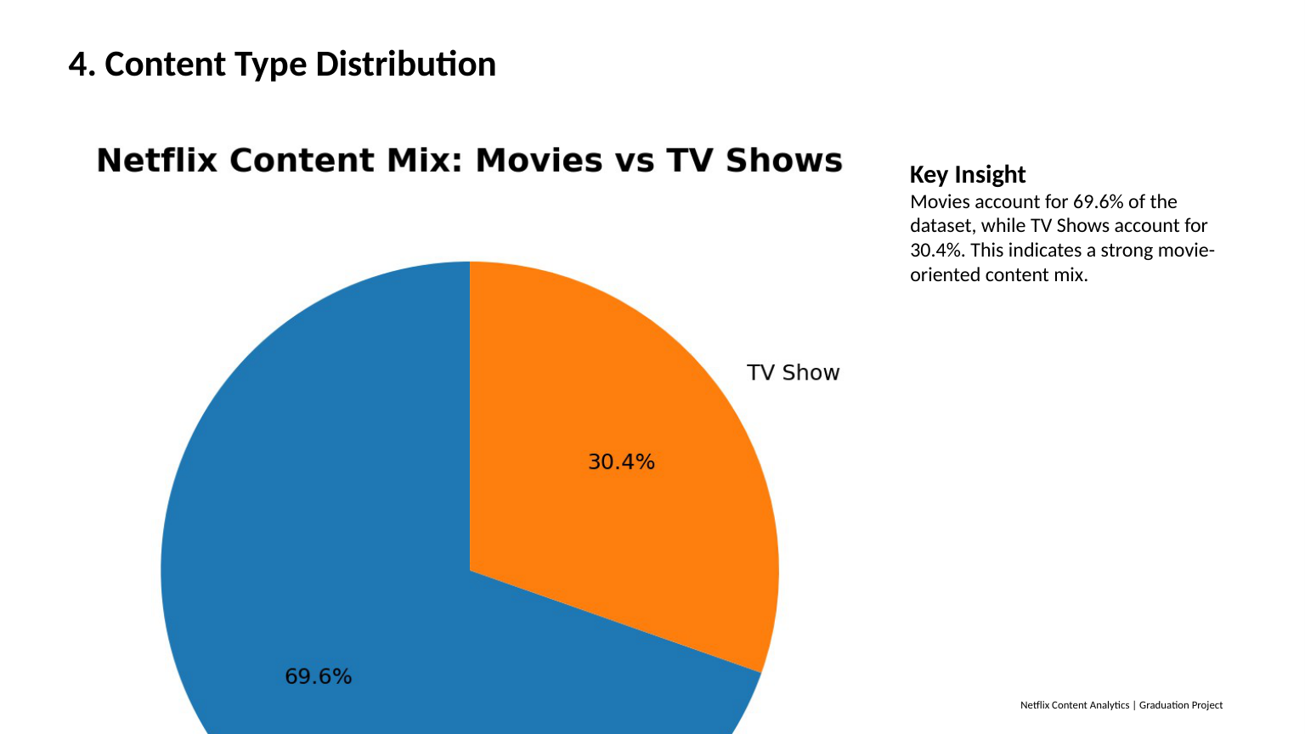
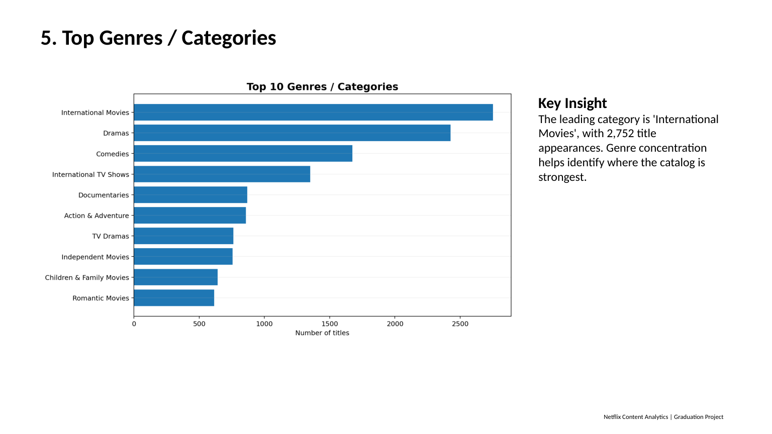
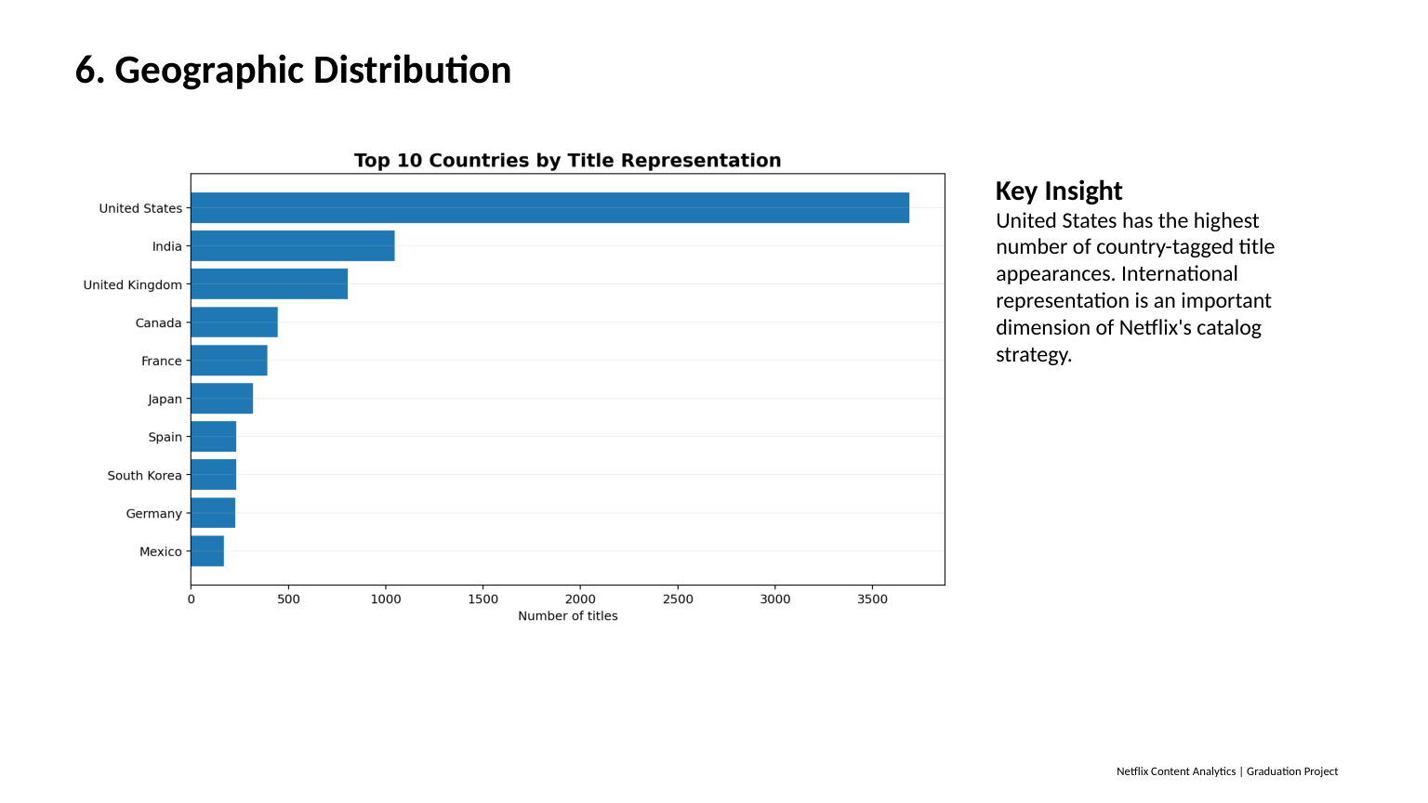
Netflix Content Analytics Dashboard
One-page summary of the project's core KPIs and visual findings
8,807
Total Titles
6,131
Movies
2,676
TV Shows
99.6 min
Avg. Movie Duration
Content Type
Top Genres
Geographic Distribution
Content Ratings
Dashboard combines existing project visuals; it summarizes catalog content, not user viewing behavior.

Slide 15
13. Statistical Analysis
Movie duration — Mean: 99.58 minutes.
Movie duration — Median: 98.00 minutes.
Movie duration — Standard deviation: 28.29 minutes.
Movie duration — Minimum: 3 minutes; Maximum: 312 minutes.
Release year — Mean: 2014.18; Median: 2017; Standard deviation: 8.82.
Standard deviation measures how spread out values are around the mean; it is NOT the square root of the mean.
Netflix Content Analytics | Graduation Project

Slide 16
14. Business Insights
Maintain a balanced content portfolio while using performance data to prioritize high-demand categories.
Use genre and rating patterns to support audience segmentation and targeted content acquisition.
Continue monitoring international content because country diversity can support global market reach.
Analyze release-year trends to balance new releases with evergreen catalog content.
Use movie-duration and TV-season distributions when planning recommendation and discovery experiences.
Improve data completeness for director, cast, and country fields to strengthen downstream analytics.
Netflix Content Analytics | Graduation Project

Slide 17
15. Recommendations & Future Work
Build an interactive Power BI or Tableau dashboard with the same KPIs and filters.
Develop a content-based recommendation system using genre, description, cast, director, and country.
Perform time-series analysis of content additions and identify expansion patterns.
Compare content strategy by country and rating.
Add user-level viewing or engagement data in future work to connect catalog size with actual performance.
Apply machine learning for content classification or popularity prediction when suitable target data is available.
Netflix Content Analytics | Graduation Project

Slide 18
16. Conclusion
The cleaned dataset contains 8,807 Netflix titles across 17 fields.
The project demonstrates a complete BI workflow: data preparation → EDA → statistics → KPIs → visualization → business recommendations.
Charts make the main patterns easier to communicate to decision-makers.
The analysis provides a strong foundation for dashboarding and a future recommendation system.
Netflix Content Analytics | Graduation Project

